Slide 1
DOELAP Assessor Training
Using the Checklist
Idaho Falls, ID
September 2026

Slide 2
DOELAP External Dosimetry Checklist
The checklist can be found in the assessor email or at the RESL DOELAP web page
  https://resl.id.energy.gov/assessordata/dosimetry/Audit%20Sites/RDC/RDC.html
  https://resl.id.energy.gov/doelap/doelap.html
Based on DOE-STD-1095-2025
  “new” requirements are listed in red text
The checklist is not a “normative” document
  Findings are written based on Standard requirements
  Checklist is a tool for the assessor
  Personal checklists can also be used
  Additional notes in another form or location are fine

Slide 3
DOELAP External Dosimetry Checklist
Portions of the checklist can be evaluated and filled out in advance
Assessment team sends in a completed checklist with the signed assessment report and attendance sheets
  Defensibility if there are questions about whether something was evaluated
  N/A column
Findings are written based on the Standard reference, not checklist
  This wasn’t always the case in DOELAP, but is the guidance now
  Findings database

Slide 4
Discussion on Checklist Use
How do assessors use the checklist?

Slide 5
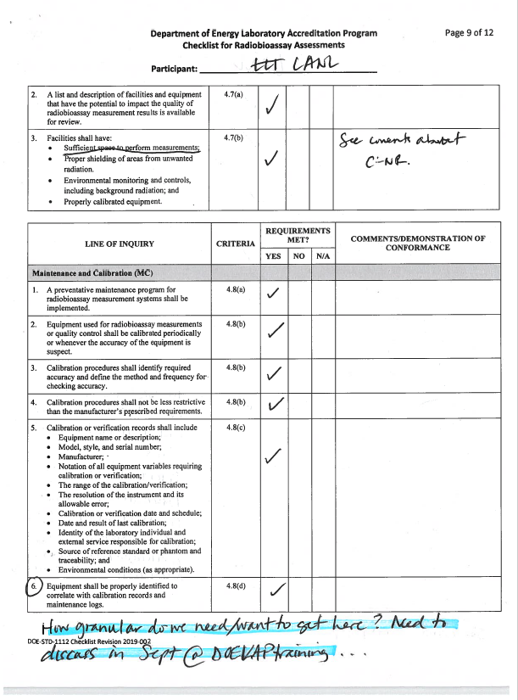
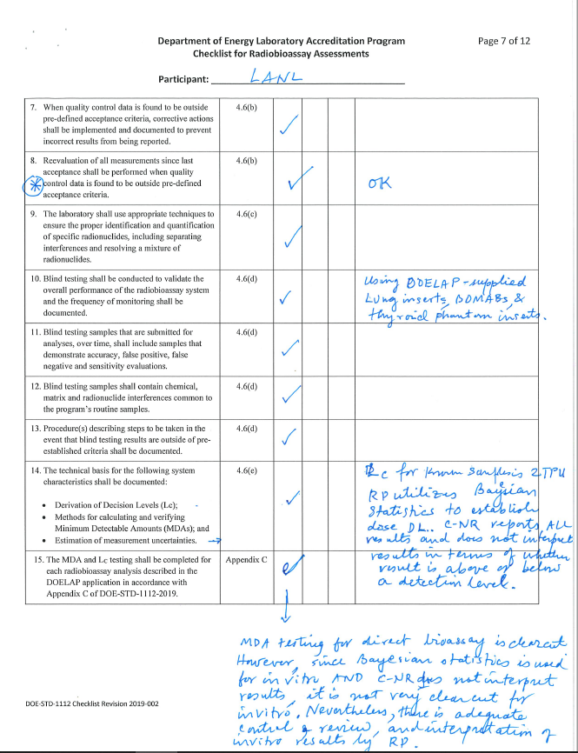

Slide 6
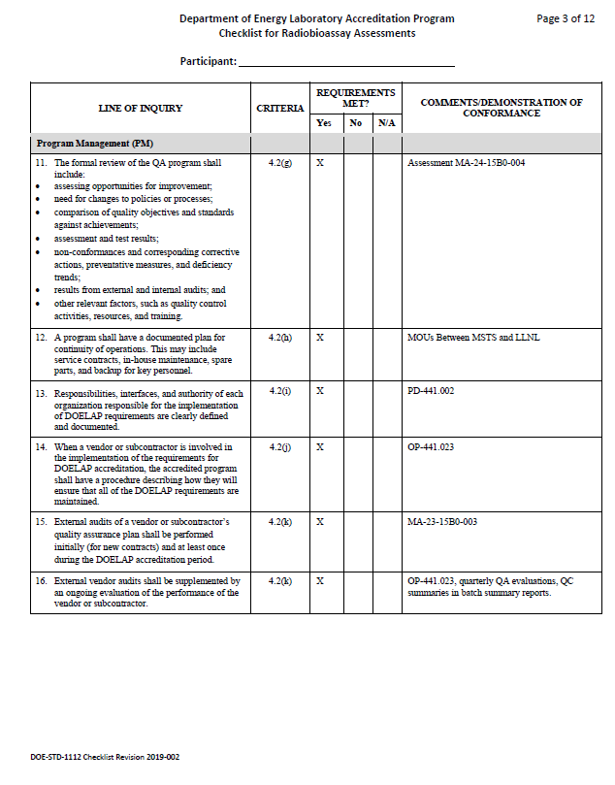
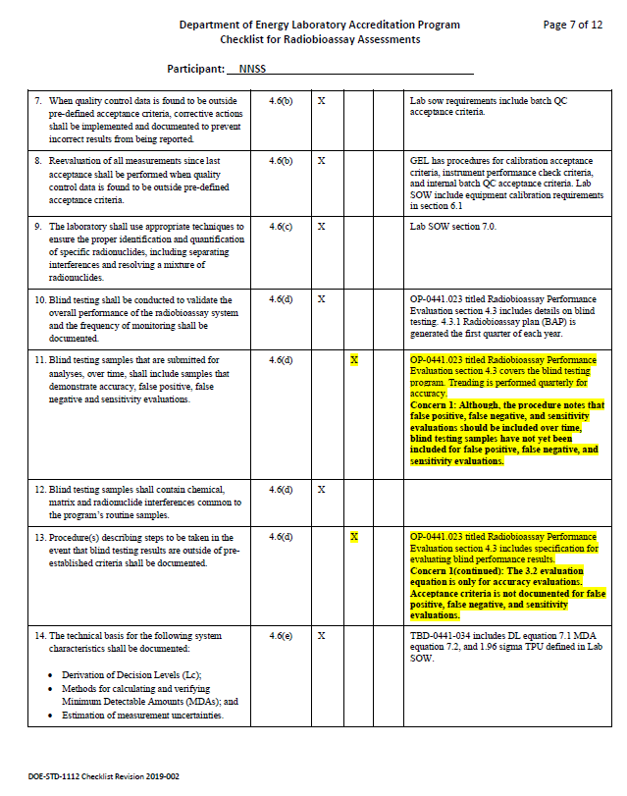

Slide 7
DOELAP Findings Database

Slide 8

Performance Testing (PT) Failures
The DOELAP OSB discussed PT failures, corrective actions, and documentation in the assessment report
Standards don’t require passing PT (immediately), 2 retest opportunities
Guidance for assessors:
  Document all DOELAP PT failures with a supporting narrative for the investigation and actions taken to resolve and prevent recurrence. Probably in the Comments for the Performance Testing section.
  DOELAP will provide the previous 2 PT reports to assessors.
  New checklist item, not necessarily a direct requirement from standard:

Slide 9
DOE-STD-1112-2019 3.2(e)
DOE-STD-1095-2025 3.2(e)
The applicant shall review the performance testing data for potential improvements in the radiobioassay (or dosimetry) measurement system.
  Management reviews
  Trending over time
  Collaboration between vendor users

Slide 10
Continuation of Accredited Activities
A program shall have a documented plan to ensure continuation of accredited activities in the event of a temporary and unexpected loss of capability up to 6 months. The documented plan shall include methods for maintaining redundant accredited measurement capabilities and methods for re-distribution of responsibilities following the loss of key personnel.

Slide 11
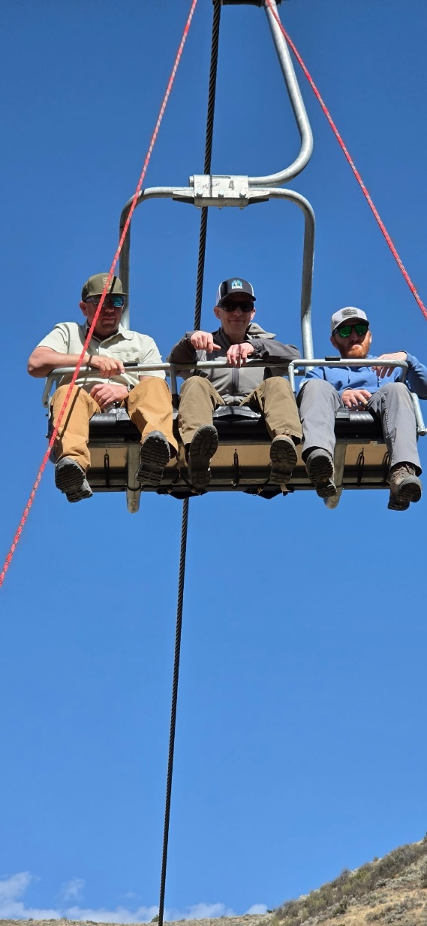

Backup plans

Slide 12
Redundant Measurement Capabilities (4.2.1)
The DOE Standard requires programs to develop plans to address temporary and unexpected loss of capability to deliver DOELAP-accredited personnel dosimetry services.
This includes:
  Reliance on external vendors;
  On-site duplicate measuring systems;
  Inter-site collaborations.

Slide 13
External Vendor Services (e.g., Landauer)
Landauer is Vendor Qualified and has demonstrated its backup systems meet DOE-STD-1095 requirements.
A program that utilizes dosimetry services from Landauer provides oversight of Landauer.
Part of the oversight should include evaluating Landauer’s backup facility (or duplicate monitoring system) capabilities.

Slide 14
Duplicate Measuring System (4.2.1(b))
Backup reader(s) are similar in configuration to primary readers.
Separate location, power source, network, etc.
  “Is the backup reader going to be taken out by a site event that takes out the primary reader?”
Maintenance (calibration, linearity, QC, preventative maintenance) should be consistent with primary systems.
Evidence (log books, calibration records, QC data) demonstrates functional equivalency.

Slide 15
Inter-Site Processing (Site A to Site B) a couple of general scenarios
Site A ships their dosimeters to Site B for processing
Site B can be interpreted to be a duplicate measuring system (4.2.1(b)).
  Site A is responsible for demonstrating equivalent performance of Site B's system for all accredited categories.
  This most likely involves initial studies with irradiated dosimeters and development of correction factors, consideration of reader setup and calibration, etc.
  Ongoing readiness requires periodic blind testing of Site B's system by Site A.
  Site B does not require DOELAP accreditation in the same categories as Site A

Slide 16
Inter-Site Processing (Site A to Site B)
Site A plans to use the dosimetry services provided by Site B.
In this scenario, Site B is a “backup” service provider, 4.2.1(c), and acts like a vendor for Site A, providing dosimeters, processing dosimeters, and providing results
Site B has a DOELAP accreditation, but Site B is not required to maintain accreditation for the same categories as Site A.
Site A is responsible for documenting that Site B has demonstrated acceptable performance in all accredited categories identified in the agreement.
Site A is responsible for ongoing blind testing of Site B, leveraging Site B's own blind testing results where applicable, but covering categories where Site B does not routinely test.

Slide 17
Guidance for Sites and Assessors
If a site has thought through possible (but not unrealistic) scenarios; performed appropriate studies; developed correction factors, transfer protocols, etc; and documented the process the intent of the Standard is being met.
Sites are encouraged to contact the DOELAP STM for guidance on evaluating their own programs.
The STM can assist with complex or unique program situations not explicitly detailed in general guidance
Assessors should contact the DOELAP Senior Technical Manager (STM) for questions or concerns during assessments.

Slide 18
Common questions
Observation of work performance
  The Technical Lead shall initially and at least annually evaluate and document the proficiency of each staff member authorized to perform dosimetry-related functions. When appropriate, this proficiency assessment should include an observation of performance. DOE-STD-1095-2025 4.4(d)
  Previous language was “shall”

Slide 19
4.8.2(e) Blind Testing
(e) Blind testing shall be conducted to validate the overall performance on all measurement systems used for the dose of record. The program shall:
• Use dosimeters irradiated by traceable isotopic sources or x-ray beams to doses that are unknown to the processor;
• Have documented procedures describing steps to be taken if blind testing results are outside of pre-established criteria;
• Test all categories throughout the 3-year accreditation period for which the program is accredited;
• If accredited in Category IIA, programs shall include at least 2 x-ray beams from 20 keV to 70 keV and at least 2 x-ray beams from 70 keV to 300 keV. Cesium-137 (Cs-137) and/or cobalt-60 (Co-60) shall always be included;
• If accredited in Category IIIA, programs shall include strontium (Sr) and/or yitrium-90 (Y-90) and krypton-85 (Kr-85); and
• If accredited in Category VA, programs shall include both bare and moderated californium-252 (Cf-252).

Slide 20
4.10 Reporting
Our assessors should apply flexibility in the interpretation of DOE-STD-1095-2025, section 4.10, ‘Reporting.’
If there are elements of section 4.10 that are not on individual dose reports, then assessors should verify that the information is included in programmatic documents or records and can be tied to an individual worker. There may not be a single document that contains all the information in section 4.10; rather, it might be a collection of documents or electronic files (e.g., database tables, investigation reports, technical basis documents, etc.). Title 10 Code of Federal Regulations Part 835, section 702 (g) requires “data necessary to allow future verification or reassessment of the recorded doses shall be recorded.” It is in this spirit our assessors should assess section 4.10.

Slide 21
DOE-STD-1095-2025
Management Review (§4.3(g))
Management shall conduct a formal review of the personnel dosimetry QAP during the 3-year DOELAP accreditation cycle. The review shall be completed at least one year before the accreditation end period so that it is available for the DOELAP on-site assessment. Management shall consist of the Quality Lead, Technical Lead, and a member of management that has authority for allocation of resources. At minimum, the review shall include:
  Assessing opportunities for improvement and the need for changes to policies or processes;
  Comparison of quality objectives and standards against achievements;
  Assessment and test results;
  Non-conformances and corresponding corrective actions, preventative measures, and deficiency trends;
  Results from external and internal audits;
  Continuation of accreditation activities plan and any associated agreements; and
  Other relevant factors, such as quality control (QC) activities, resources, and training.

Slide 22
DOE-STD-1095-2025
Appendix C – Example Management Review Template
Prepared and to assist sites in meeting the requirements of 4.3(g)
Not required to be used

Slide 23
Programs that use vendors
Both 1095 and 1112 include essentially the same requirements:
  The DOELAP accredited program has the responsibility for ensuring the requirements of this technical standard are met.
  The program shall have a procedure for conducting quality assurance assessments of the service provider; that includes on-site audits, quality control reviews, and blind quality control [audit dosimeters]. The procedures shall also describe how findings are identified and corrected.
Group assessments of DOELAP-Qualified Vendors
DOELAP checklist? DOELAP Vendor Qualification assessment report? Individual SOW requirements

Slide 24
General Thoughts on Interpretation
Other questions – where the DOELAP Standards are not specific or don’t address the particular topic, DOELAP gives latitude to site needs.
Don’t get stuck on literal regurgitation of the specific words or language of the standard
  Allow for variation due to site processes, requirements, expertise
  Sites can’t just copy and paste the standard language with no supporting processes, procedures, documentation

Slide 25
Questions?

